Slide 1
Ministry of Education and Science of Ukraine
Kyiv National University of Construction and Architecture
Zhao Wenzhu
to the attestation graduation work
to obtain a master's degree
on the subject:
Directions for improving the financial condition of the construction enterprise
Head: Stetsenko S.P.
Belenkova O.Yu.
Kyiv 2024

Slide 2
The relevance of the topic of analytical evaluation of the personnel management system of a construction enterprise lies in the need to optimize the use of human resources to ensure competitiveness and improve performance. In today's conditions of shortage of qualified personnel, especially during martial law in Ukraine, it becomes important to formulate a strategy that allows to maximize the potential of employees, increase their motivation and improve the social and psychological climate in the team. Taking into account intellectual, human and social capital in human resources management is a crucial factor for the successful development of an enterprise in the construction market.

Slide 3
The purpose of the graduation thesis is to consider scientific and applied approaches to personnel management of construction companies.
The tasks of the certification graduation work are:
define the essence of enterprise personnel management;
to characterize the elements of the personnel management system;
to consider the methods of personnel management of the enterprise;
to give a technical and organizational description of Intergal-Bud LLC;
to determine the features of the personnel policy of “Intergal-Bud” LLC;
to diagnose the personnel management system of LLC
“Intergal-Bud” LLC;
to consider the peculiarities of the personnel management system under martial law;
to propose directions for improving the methods of personnel management of “Intergal-Bud” LLC;
to evaluate the effectiveness of the proposed measures.

Slide 4
The object of the study is the personnel management system of the construction company “Intergal-Bud” LLC.
The subject of the study is theoretical issues, methodological and practical aspects of improving the personnel management system of a construction company.
The information base of the study was the works of domestic and foreign scholars on the topic, articles in periodicals, publications of recruitment agencies, Internet resources, and enterprise information.

Slide 5
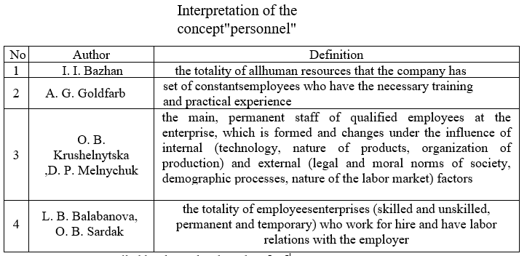
In today's business, human resources management is a critical success factor. A company's staff is a combination of all employees, from permanent to temporary. Effective HR management is aimed at fully utilizing their potential and increasing their motivation. Especially in the construction sector, the quality of work depends on the qualifications of employees, so it is necessary to develop a management system that will ensure their professional growth and efficient performance of tasks.
The main goal of human resources management is to form, develop and realize the company's human resources potential, which means improving the performance of each employee so that he or she builds up and uses his or her own labor and creative potential and thereby contributes to the achievement of the company's goals.
A fragment of the table

Slide 6
- providing the enterprise with labor force of appropriate quantity and
and quality;
- ensuring conditions for the growth of labor productivity, a sufficient level of labor motivation, self-discipline, and the acquisition of new professional skills by the employee
formation of a stable team at the enterprise;
realization of the needs and interests of employees regarding the content and working conditions, opportunities for professional and career growth;
optimization of the balance of interests of both staff and the company.
The key goals of enterprise personnel management are

Slide 7
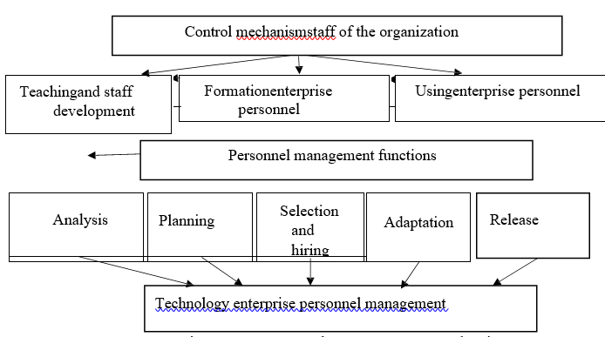
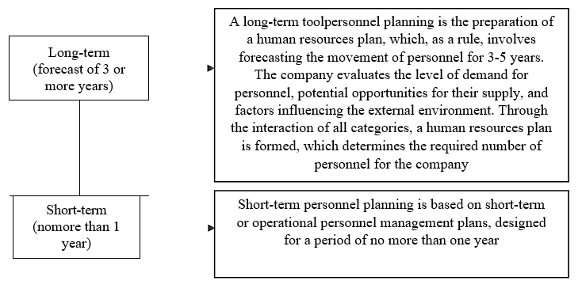
The HR management mechanism of a business organization includes the following components and procedures.
The main types of personnel planning are:

Slide 8
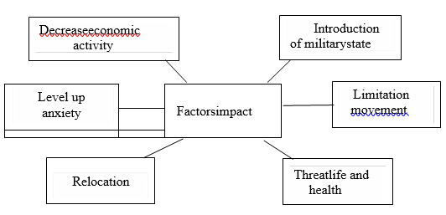
Human resources management is a strategic function that covers a set of measures to improve the company's performance by optimizing the use of human resources. Key elements and functions of the HR management system help to build loyalty, corporate culture and ensure adaptation to market changes.
The main areas of personnel management:
Setting goals - defining the main goals and objectives that contribute to the company's development.
Formation of implementation mechanisms - development of methods and procedures that ensure the effective implementation of the goals.
Organizational and functional model - a structure that integrates personnel into all divisions of the organization
Factors affecting staff in 2022

Slide 9
Controlling personnel performance ensures stability and efficiency of management, provides information for adjusting the HR strategy and influences employee behavior.
Positive impact of control:
Increased responsibility.
Motivation through evaluation, rewards or punishment.
Search for productivity and innovation reserves.
Negative impact:
Nervous tension and ostentatious behavior during inspections.
Types of control:
Internal - improving productivity and preventing conflicts.
External - verification of legality and economic feasibility.
HR management in a crisis:
In wartime, it is important to adapt the strategy, protect employees and communicate clearly.
The HR department should maintain stability, provide training, and ensure that information is accessible and timely.

Slide 10
Personnel management methods are methods of influencing employees to achieve company goals.
Main methods:
1. Administrative: Used to maintain discipline and organizational clarity. They include normative documents that regulate the activities of personnel, and measures of administrative penalty in case of their violation.
2. Economic: Labor resources are mobilized through economic incentives, such as material incentives and participation in the company's profits.
3. Socio-psychological: Based on psychological influence and social relations to form the internal desire of employees to perform work without administrative influence. They include moral incentives and the creation of a favorable psychological climate in the team.
Innovative methods of personnel management:
recruitment,
performance evaluation,
training,
reward system
career management.

Slide 11
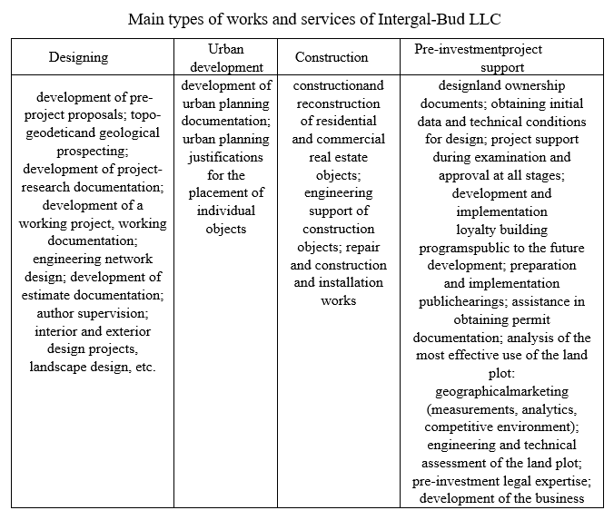
"Interhal-Bud" LLC:
Founded in 2003 in Lviv.
It belongs to the "Intergal" group of companies with various areas of activity, in particular development.
It is among the TOP-10 largest construction companies of Ukraine, and recognized as the largest developer of Kyiv in 2022.
Projects:
More than 40 projects have been implemented in Ukraine, 12 of them in Kyiv (for example, "Nyvky-Park", "City Hub", "Sky Avenue").
As of 2022, 12 projects in Kyiv are in the active stage of implementation.
Organizational structure:
A linear-functional management structure where the CEO is responsible for overall management.
Subdivisions help in the performance of management functions, ensuring a clear demarcation of responsibilities.
Impact of war:
Martial law reduced the share of construction in GDP to 1.9% in 2022. Many construction companies have suspended work or repurposed to support the Armed Forces due to lack of resources and risks.
Prospects:
It is expected that the restoration of energy supply will contribute to the stabilization and growth of the construction market.

Slide 12
HR policy of "Intergal-Bud" LLC
The number of employees increased steadily from 2020 to 2022, increasing by 94 people in 2022.
The largest share of personnel works in the construction department and the architectural department, which reflects the specifics of the company's activities.
Mostly men work (70% in 2022) due to the physical complexity of construction work.
The majority of employees have a higher (35%) or secondary professional education (38%), which ensures an adequate level of qualification.
The average salary in the company grew steadily and in 2022 was 16% higher than the average in the Ukrainian market.
Labor costs will account for 84% of total personnel costs in 2022.
The company invests in training, which increases the motivation and qualification of employees.
Labor productivity fell by 54% in 2022 due to the reduction in net income caused by war-related restrictions.

Slide 13
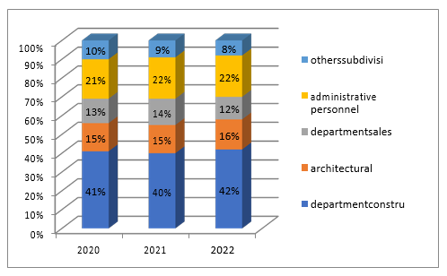
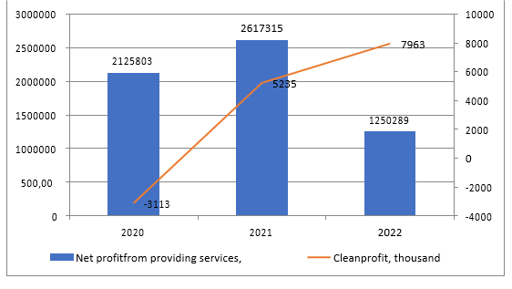
Structurepersonnel of Intergal-Bud LLC
for 2020-2022 divisions
Dynamics of the net income of "Intergal-Bud" LLC for 2020-2022, thousand hryvnias

Slide 14
Diagnostics of the personnel management system of "Interhal-BUD" LLC
The structure of the personnel department: It consists of three divisions - personnel administration, work with personnel, training and development. Each unit is responsible for different aspects, including documentation, recruitment, training, adaptation and development of personnel.
Personnel planning: Based on forecasts of the number of projects and volumes of construction work. For administrative staff, the number of transactions, documents and counterparties is taken into account.
Adaptation of staff: Includes mentoring and training, process control by managers who help new employees integrate.
Recruitment: It is carried out through employment sites, cooperation with universities, job fairs.
Redundancy: Includes measures to comply with legal regulations and support employees during dismissal, with analysis of reasons for improving personnel management.

Slide 15
Factors affecting personnel at Intergal-Bud LLC under martial law conditions in 2022-2023
Factorsimpact on the activities of the LLC
"Interhal-Bud"
Decreaseeconomic activity - reduction in the number of orders / construction projects
Introduction of militarycondition with all accompanying factors
An increase in the level of anxiety is an unstable emotional state of the staff
Threatlife and health of employees
Relocation from temporarily occupied territories to Kyiv or Western regions

Slide 16
In the conditions of martial law, the personnel management system of enterprises, in particular "Intergal-Bud" LLC, underwent significant changes. Key features include:
Reduction and optimization of staff: Decrease in orders and income led to forced reduction of employees and postponement of projects. However, this raises the risk of a lack of qualified personnel in the future.
Changes in labor relations: Martial law provides for an increase in the working week to 60 hours, the possibility of working at night for women, simplification of the processes of dismissal and hiring on fixed-term contracts. The law allows dismissal without notice for workers from dangerous areas.
Adaptation of work during crisis situations: Due to regular power outages and air strikes, staff, especially administrative ones, work remotely, but with risks. Remote work is not possible for construction workers, which creates additional difficulties.
Psychological support and empathy: The company provides psychological support, involves employees in volunteer projects and fundraising for the army, which has become a new type of motivation.
Training and rotation: If possible, the company organizes training and rotation of employees, preserving personnel potential for post-war recovery.

Slide 17
The following are the main areas of improvement of personnel management methods at "Intergal-Bud" LLC
Analysis of personnel potential:
Assessment of the actual number of personnel and its compliance with the scope of work.
Development of an anti-crisis plan, which includes redistribution of tasks, partial payment of labor depending on the volume of tasks performed and support of employees in stressful conditions.
Personnel planning:
Taking into account the current status of orders and possible interruptions in construction.
Parallel review of the company's strategy to optimize the number and structure of personnel.
Search and recruitment of personnel:
Current hiring freeze due to insufficient staff.
After the victory, it is planned to expand the search channels, including active cooperation with universities to train young specialists.
Adaptation of personnel:
Implementation of adaptation processes for new employees, with a special emphasis on psychological support for those who arrived from the occupied territories.
Staff training:
Activation of professional training, especially for construction personnel.
Development of trainings to improve the quality of construction services and psychological trainings to support the morale of employees.
Staff motivation:
Introduction of partial payment depending on workload (70-80%).
Use of non-material motivations for personnel with a limited scope of work.

Slide 18
Recommendations for improving personnel management in Intergal-Bud LLC:
Anti-crisis plan of personnel potential:
Develop an anti-crisis plan to maintain the staff, which includes the redistribution of duties between employees and partial payment of labor in accordance with the volume of tasks performed.
Cooperation with educational institutions:
After the end of martial law, to establish contact with institutions of higher education to attract new personnel, organizing practice for students of construction specialties with the possibility of further employment.
Personnel planning taking into account military risks:
Carry out workforce planning according to the current volume of construction projects and potential changes in the planning of operations due to risks (project freezes, supply interruptions).
Special attention to the adaptation of workers from the occupied territories:
Provide support and specialized adaptation for new workers from temporarily occupied territories, including psychological assistance.
Increasing the effectiveness of staff training:
Expand the training program by organizing professional training (in particular on the quality of construction services) and psychological classes to maintain the morale of employees in conditions of military stress.
Flexible motivation system:
Implement flexible workload-based pay to keep workloads motivated and optimize staffing costs.
Psychological support and empathy in management:
Provide psychological support for employees, develop corporate values, increase empathy, organizing mutual support in the team and considering the possibility of volunteer projects to support mobilized employees and the Armed Forces.

Slide 19
The expected effect of the implementation of the recommendations:
Optimizing personnel costs and increasing the efficiency of personnel management.
Ensuring readiness for future expansion of projects after the end of the war.
Maintaining the moral and professional level of employees, which will create a stable basis for the rapid recovery of the company.

Slide 20
Thank you for your attention!

