Slide 1
Ministry of Education and Science of Ukraine
Kyiv National University of Construction and Architecture
Tian Yu
to the attestation graduation work
to obtain a master's degree
on the subject:
Theoretical and methodical aspects of working capital management of construction enterprises
Head: Stitsenko V.I.
Zapechka Yu.O.
Kyiv 2024

Slide 2
The relevance of the topic lies in the fact that in the conditions of market relations, each enterprise, in particular in the food industry, needs to ensure a high level of competitiveness and effective management. Increasing the competitiveness of enterprises requires the ability to quickly adapt to changes in the external environment, make effective management decisions and implement innovations. Given globalization and changing market conditions, it is especially important to develop small businesses as a mobile link in the economy that can contribute to improving the country's competitiveness. The study of competitiveness and management mechanisms, as well as state support, is essential for the development of food industry enterprises and the improvement of the economic situation in the country.

Slide 3
The processes of globalization and integration affect the economy, in particular through trade liberalization, market opening and increased competition.
To achieve competitiveness, it is important to ensure high quality standards, innovation and environmental friendliness.
The competitiveness of an enterprise determines its ability to function effectively in the context of globalization and changing market conditions.
Increased competitiveness contributes to the country's economic development, higher living standards and food security.
The competitiveness of an enterprise is the ability to outperform competitors due to advantages in quality, price and other aspects.
Basic definitions of the category “competitiveness”
M. Porter: competitiveness is the ability of a producer to be competitive in the market, both domestic and foreign.
V. Vasylenko: competitiveness is an advantage of an enterprise over its competitors.
G. Voronin: competitiveness depends not only on the price and quality parameters of products, but also on the level of management, financing and innovation.

Slide 4
The development of small businesses in most foreign developing countries is primarily due to a convenient system of regulation and support for small businesses, primarily manifested through the use of active government support at all levels of government
The study showed that in the country of the World, enterprises that meet certain characteristics are considered small, namely:
- qualitative - business entities are independent and managed by owners or co-owners, the activities of such enterprises are mainly local in nature and cannot significantly affect prices and revenues in their industry, and in the event of bankruptcy of such an enterprise, the economic and social impact will be insignificant and hardly noticeable;
- quantitative - by certain statutory criteria. Each country uses its own set of criteria that corresponds to the peculiarities of the development of its business sector.

Slide 5
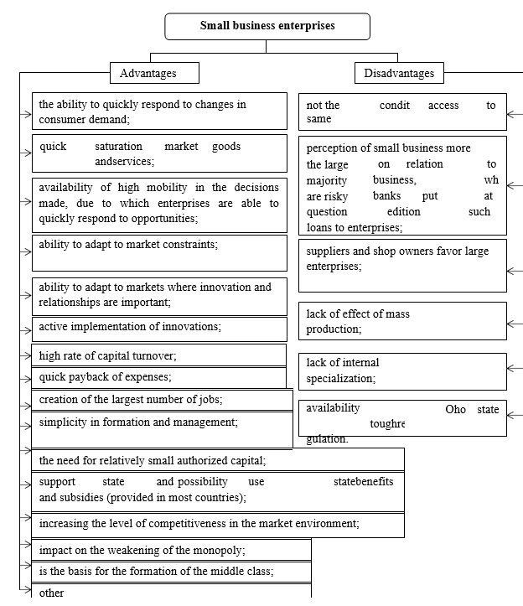
The study showed that many small businesses in Ukraine find it very difficult to cross the 1-3 year mark. According to some Western experts, only one out of three small firms can survive on the market for more than four years. The majority of bankruptcies are usually associated with ineffective management, including due to the lack of internal specifications at enterprises.
Internal resources that can be adapted to changes in the external environment are especially important for small business enterprises.
Taking into account state support, efficient use of investments and adaptation to the latest technologies should become a strategic priority to ensure competitiveness.

Slide 6
The development of the functioning of enterprises, in turn, is influenced by many factors, among which, first of all, the following should be noted:
- the ability of the state to respond quickly to external factors of influence in the national and international economies;
- the ability of enterprises to quickly counteract external and some internal factors of influence.
In our opinion, the result of an increase in the level of efficiency of each enterprise is:
- successful economic and regulatory policy of the state and support of domestic producers;
- protection of domestic producers and the domestic market of the country from low-quality goods and unscrupulous foreign producers, raider attacks on enterprises, etc;
- implementation of an effective financial and credit policy in the country;
- ensuring the efficiency of the enterprise through the implementation of effective management decisions;
- ensuring competitiveness at enterprises as a result of their continuous development and creation of special competitive advantages.

Slide 7
Methods of assessing the competitiveness of the enterprise | Characteristics of methods, possible advantages and disadvantages
Methods of assessing competitiveness by market share | Divides subjects of market activity into: outsiders, subjects with a low, medium and strong competitive position and leaders of market activity. The magnitude of the change in the market share makes it possible to determine certain groups of economic units, the size and dynamics of market shares makes it possible to build a competitive map of the market, which determines the degree of dominance in the market, the peculiarities of the development of the competitive situation.
Methods built on the basis of the theory of effective competition | Comparison of the position of enterprises of the industry with competing enterprises and average industry indicators by groups of indicators (efficiency of the enterprise's production and sales activities, financial stability, quality of the enterprise's products"). The advantages of this method are that with its help it becomes possible to identify the weaknesses and strengths of an enterprise in relation to another, to evaluate the exchange of the backlog, to develop management actions to strengthen weak points. The disadvantages include the fact that it is quite difficult to collect all the information necessary for calculating indicators, and the calculations themselves are extensive and time-consuming.
Matrix and graphical methods of assessing competitiveness | Research on the development of competitiveness in dynamics. The advantages of these methods are ease of understanding and visibility. Among the shortcomings of these methods, it should be noted that they do not provide the necessary systemic view of competitiveness, do not take into account the different weights of its factors.
The methods of assessing the level of competitiveness for small business enterprises, presented in the fragment of the table, are extended assessment options that allow each enterprise to choose the most optimal method, taking into account the type of activity and operating conditions. The analysis of scientists' works showed that quantitative assessment methods help to determine the ability of an enterprise to make effective management decisions and capture strategic areas in the market. However, to assess the competitiveness of small business enterprises, it is recommended to use combined methods that are systematic, but less complicated in calculations.

Slide 8
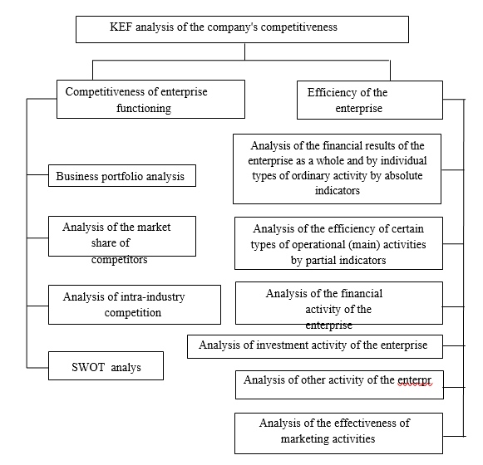
K.O. Vaskovska proposed to combine the methods of the theory of effective competition and competitiveness into CEF-analysis (a comprehensive methodological approach to competitiveness analysis), which allows to assess the efficiency of the enterprise and its competitiveness using a system of indicators.
We have supplemented and formed an approach to the analysis of the competitiveness of the enterprise by K.O. Vaskovska.

Slide 9
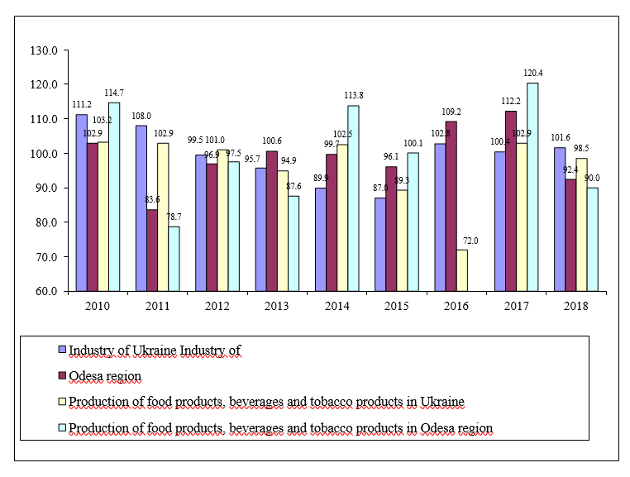
Sustainable development of the country requires an analysis of trends in the food industry. The study of the efficiency and competitiveness of enterprises in this industry in Ukraine and Odesa region is relevant, as many enterprises face problems in the domestic and foreign markets and need to improve their performance and competitiveness.
An analysis of industrial production in Ukraine and Odesa region for 2010-2018 showed that Ukraine has been on a steady downward trend since 2013, while Odesa region experienced periods of growth in 2013, 2016, and 2017. In 2018, production volumes in Ukraine slightly increased, while in Odesa region they decreased. Growth peaked in 2010 and 2017 in Ukraine, and in the Odesa region in 2010 and the period from 2014 to 2017. Despite the volatility, the food industry remained a working industry.
In 2018, the number of food processing enterprises in Ukraine increased by 1.62% compared to 2016 and by 2.88% compared to 2017, in particular in the segments of processing of fruits and vegetables, dairy products, bakery products and other food products.

Slide 10
Main trends in the food industry of Ukraine (2014-2018)
Decrease in the number of enterprises:
The production of oil and animal fats, flour and cereal products, ready-made feed, and beverages (especially spirits and grape wines) shows a negative trend towards a decrease in the number of enterprises in the respective industries. This indicates problems in some key sectors of the food industry, particularly those that are export-oriented.
Small businesses and their difficulties:
The increase in the number of small enterprises was insignificant, due to high competitiveness requirements and the need for state support. Decrease in the number of small enterprises was observed in the wine and oil and fat industries.
Industrial production indices:
The 1.5% decline in the food production indices in 2018 compared to the previous year indicates a gradual decline in production activity, accompanied by long-lasting fluctuations in different sectors.
Growth in some sectors:
Despite the overall decline, there was an increase in the production of some products, such as wines, water, and frozen chicken meat, indicating some positive developments in certain subsectors.
Production structure:
Data for 2014-2018 show changes in the production of key products such as sausages, oil, milk, flour, and bread. For example, in 2018, the production of flour and bread decreased, which negatively affects the country's food security.
Negative trends in some types of products:
A drop in production of chicken and pork meat, as well as some prepared foods. However, positive dynamics are observed in the segment of natural water and wine production.

Slide 11
A study of the food industry in Ukraine showed their unstable development in the period from 2010 to 2018, with “wave-like” changes in production and sales volumes. Declining capital investment, especially in the southern regions, particularly Odesa region, may slow down the development of small businesses in this sector. This threatens to reduce the production of strategically important food products, which has an impact on exports and requires finding solutions to increase the competitiveness of food industry enterprises.
Regions | 2014 | 2015 | in % to 2014 | 2016 | in % to 2015 | 2017 | in % to 2016 | 2018 | in % to 2017
Ukraine | 219420 | 273116 | 98.3 | 359216 | 118.0 | 448462 | 122.1 | 578726 | 116.4
Regions
Volynsk | 3390 | 6167 | 137.7 | 6384 | 97.5 | 7042 | 105.5 | 8687 | 112.1
Kyivska | 19653 | 24359 | 99.0 | 33411 | 124.8 | 34494 | 94.1 | 40713 | 109.8
Mykolayivska | 3771 | 5990 | 126.1 | 9730 | 147.6 | 11178 | 108.2 | 10099 | 87.4
Odesa | 9361 | 9984 | 79.6 | 16729 | 163.4 | 22300 | 128.8 | 23788 | 95.9
Poltava | 8828 | 8338 | 70.0 | 15265 | 132.2 | 15855 | 133.8 | 18637 | 105.5
Capital investments in some regions of Ukraine (UAH million)

Slide 12
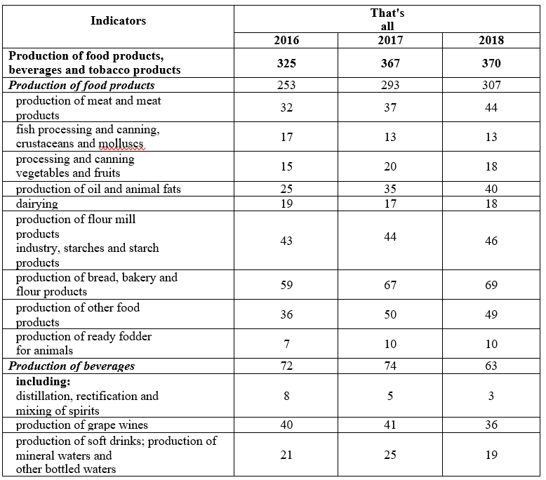
Odesa region has significant potential for food industry development due to its resources, climate, and convenient transportation. However, the main problems are a lack of financing and loss-making enterprises. In particular, the wine industry faces difficulties due to the state of the raw material base and the tax burden.
In 2016-2018, the number of food production companies increased, but the number of beverage producers decreased. A positive trend is the decline in the share of loss-making companies. However, the decline in production volumes in a number of categories (beverages, canned vegetables) indicates problems in the industry.
In particular, in 2018, there was an increase in the production of chicken meat, fish, apple juice, and jams. Development trends point to changes in structures and require addressing financing and efficiency issues to ensure sustainable development.
Number of enterprises of Odesa region by types of food industry

Slide 13
Having analyzed the food industry of the Odesa region, the following main trends in the development of food industry enterprises in the Odesa region for the period from 2014 to 2018 can be distinguished:
Decreasing the number of employees
From 2014 to 2018, the average registered number of employees in the food industry of the Odesa region decreased. This may indicate a decrease in production volumes, as well as a decrease in the efficiency of enterprises.
High employee turnover
During this period, a high percentage of employees left enterprises, reaching 67.6% in 2018. This indicates problems with staff retention due to low wages and inadequate working conditions
Wage growth
The average monthly wage of employees increased from UAH 3,427 in 2014 to UAH 9,501 in 2018, which indicates an increase in the level of wages. However, this factor did not always help reduce staff turnover.
Increasing capital investments
There is a gradual increase in capital investments in food industry enterprises, in particular in the production of meat and meat products, processing of fruits and vegetables, and the wine industry. This may indicate the prospects of these sectors in the region.
Decreasing foreign investment volumes
In general, foreign investment in the food industry of Odesa region shows instability, especially in 2017, which indicates risks for investors and economic instability.

Slide 14
Instability of financial indicators
There was a significant fluctuation of financial results before taxation and profitability, which indicates the instability of profitability of enterprises and their vulnerability to external influences. A slight improvement was recorded only in 2018.
Need for government support
Trends indicate a need for government support, especially for industries such as oil production, flour and grain products, fruit and vegetable canning, beverage production and viticulture, which require investment to increase efficiency and development.
Expansion of production of certain types of products
Positive changes are observed in the production of soft drinks and winemaking. The growth of investments and the increase in production volumes in these industries indicate their strategic importance for the region.
Gradual growth in sales volume
Sales volume increased until 2018, which confirms the stable demand for food industry products, although the growth rate decreased due to financial and personnel problems.
These trends indicate the need for a comprehensive approach to the stabilization and support of the food industry in the Odesa region, in particular, improving working conditions, attracting investments, and developing state programs to support priority areas.

Slide 15
Given the instability of the economy and the dynamics of market conditions, small businesses in the food industry need to implement new tools to ensure competitiveness. An important role in this is played by the methods of marketing activity, as well as the experience of public-private partnership, which contributes to the development of innovations.
Research by N.L. Schlafman distinguishes three types of outsourcing organization (cluster, centralized, decentralized) and three types of services (full package, partial package, without investment resources). The most common are IT outsourcing and business process outsourcing, which allow companies to transfer non-core processes to third-party organizations.
Small businesses in the food industry can benefit from outsourcing practices such as subcontracting, a type of industrial outsourcing. It involves cooperation with large enterprises through the transfer of part of production tasks to small specialized companies. This model is especially important for enterprises seeking to improve efficiency, reduce costs and focus on core business objectives.
In general, the concept of "subcontracting" is rarely used in Ukraine and requires the development of a regulatory framework for active application. The development of such tools as subcontracting can significantly improve the competitive position of small enterprises, stimulating their cooperation with large manufacturers.

Slide 16
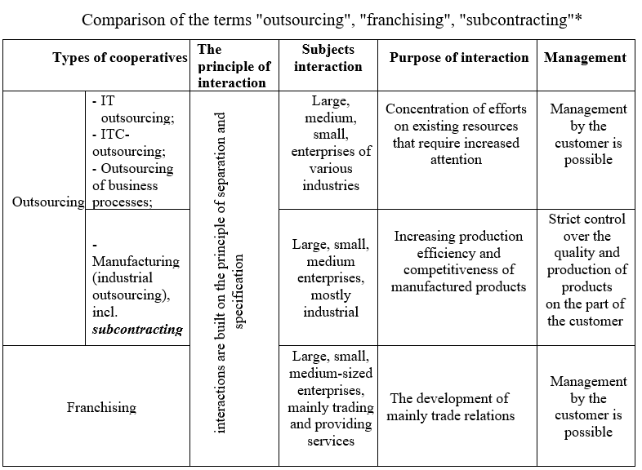

Slide 17
The methods of assessing competitiveness for small businesses in the food industry are considered. The author proposes a comprehensive method that combines the theory of effective competition and the method of competitiveness, adapted to the specific limitations of such enterprises (small market size, limited financial resources, influence of external factors, etc.)
The «EFC Analysis System» is structured into three levels: performance efficiency, competitiveness of operation, and analysis of financial indicators (revenues, operating efficiency, development prospects).
The key parameters are:
IBDP (Business Development Prospects Index) - is determined by the McKinsey matrix, which takes into account market attractiveness and competitive position.
- Market Share Index (MSI) - reflects the market share relative to the leader.
- Iex (exclusivity index) - the level of business customization that contributes to the attractiveness of the client.
The method allows to calculate the overall competitiveness index (Іcom(sb)), where the higher the value, the better the company's position in the market.
Food companies can use product customization (changing the recipe, individual design, personalized packaging). This approach creates a sense of uniqueness among consumers and helps to increase loyalty.

Slide 18
Indicators that create a comprehensive system for measuring and assessing competitiveness, which allows to identify weaknesses and optimize various aspects of small business.
Financial position - is determined by such indicators as absolute liquidity ratio, autonomy ratio and others that reflect the company's ability to meet its obligations.
Operating activities - includes indicators such as material efficiency, labor productivity, and profitability of the main operating activities.
Security and breakeven - includes margin profit, critical production volume and margin profit ratio.
Sales efficiency - assessed by sales profitability, finished goods overstocking ratio, etc.
Marketing activities - includes the advertising efficiency ratio, the percentage of loyal customers, which allows analyzing the impact of marketing activities on business profitability.
These indicators create a comprehensive system for measuring and assessing competitiveness, which allows you to identify weaknesses and optimize various aspects of small business.

Slide 19
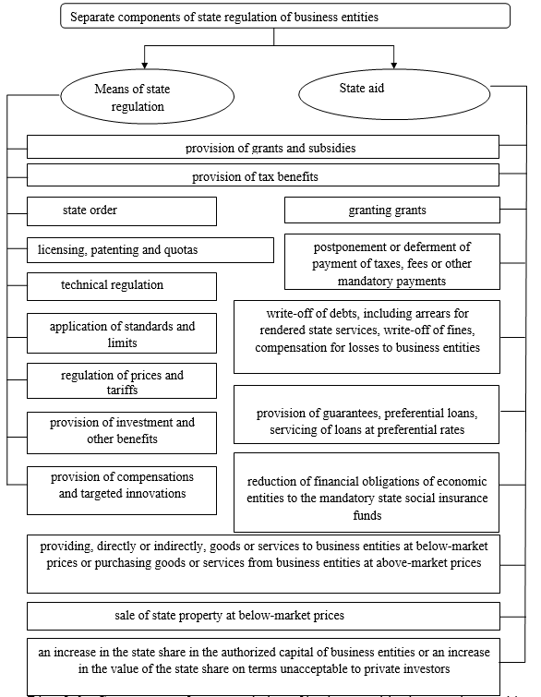
The main idea of analyzing the level of business customization is to assess the production cycle, which allows you to determine how flexible a business is in meeting individual customer needs. The shorter the production cycle, the higher the level of customization, which allows for faster adaptation to market needs.
To evaluate the efficiency of small businesses, a system of indicators is used, structured by areas:
1. Financial condition of the enterprise. This block covers the analysis of liquidity, financial stability and other financial indicators that ensure the stability and autonomy of the enterprise.
2. operating activities. The efficiency of resource utilization, labor productivity, capital efficiency and other indicators characterizing the profitability of production are assessed.
3. Security and breakeven. Includes an analysis of marginal profit, safety factors that allow the company to avoid unprofitability.
4. Sales system efficiency. Covers sales performance indicators, including overstocking of finished goods and production capacity utilization.
5. marketing activity. This includes advertising and customer loyalty efficiency ratios that contribute to retaining and attracting new customers.
Thus, this approach makes it possible to comprehensively assess the company's activities in various areas and identify key aspects for increasing competitiveness and adapting to market conditions.

Slide 20
Thank you for your attention!

