Slide 1
Ministry of Education and Science of Ukraine
Kyiv National University of Construction and Architecture
Han Xiaoxiao
The graduate thesis
to obtain the master's degree
on the subject:
Profitability as an efficiency indicator of a construction enterprise performance
Head: Stitsenko V.I.
Zapechka Yu.O.
Kyiv 2024

Slide 2
The relevance of the research topic is due to the growing importance of organic production in the global market and the need to improve management methods to increase the efficiency of production and marketing of organic products. In Ukraine, there is an increase in the area of land for organic production, but there are problems with low demand and insufficient consumer awareness. The use of integrated management practices allows for efficient production and marketing, which is also important for other sectors, such as construction.

Slide 3
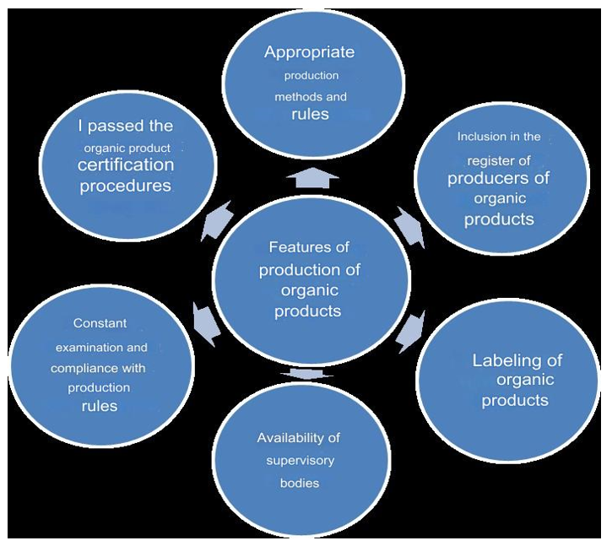
Organic products are environmentally friendly products that meet approved quality standards, are certified and labelled accordingly. Such products do not contain chemical fertilisers, pesticides, GMOs and are produced with minimal environmental impact.
The production of organic products is characterised by certain peculiarities, which are partially reflected in the Law of Ukraine ‘On the Production and Circulation of Organic Agricultural Products and Raw Materials’ [2] and in the works of many scientists.
We propose to highlight the following features of organic production:

Slide 4
Organic product promotion management is a set of actions aimed at the constant interaction of management functions to ensure that products enter the market, increase their recognition and meet consumer demand while maintaining environmental and quality standards.
Modern technologies (Internet, mobile applications, computer systems) are an important component of promotion management, helping to optimise communication with consumers and build a positive perception of organic products. Promotion management of organic products requires efficient logistics systems for transport and storage, especially for perishable products. Logistics allows for the establishment of a distribution system that ensures that products reach the end consumer in a timely manner. To effectively promote organic products on the market, it is necessary to use a comprehensive strategy that integrates various management approaches (organisational, marketing, functional, process) and takes into account the peculiarities of digitalisation and logistics.
The main functions of promoting organic products:
Quality assurance: Ensuring consumer confidence in the environmental friendliness of the product.
Growth in demand: Increasing interest in the health benefits of products.
Stimulating purchases: Focus on health and environmental friendliness.
Brand awareness: Expanding influence through interaction with consumers.
New customers: Attracting new customers through positive feedback.
Adaptation of presentation: Taking into account the cultural characteristics of markets.

Slide 5
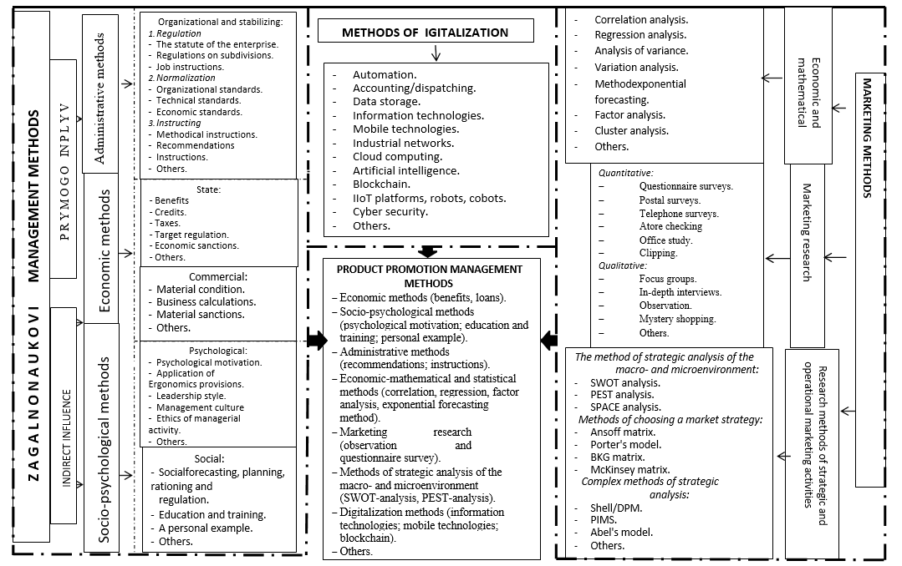
Based on the analysis of scientific literature, the article systemises the above methods of management, marketing activities and digitalisation, which form the basis of a comprehensive scientific and methodological support for product promotion management and are recommended for use in the process of product promotion.

Slide 6
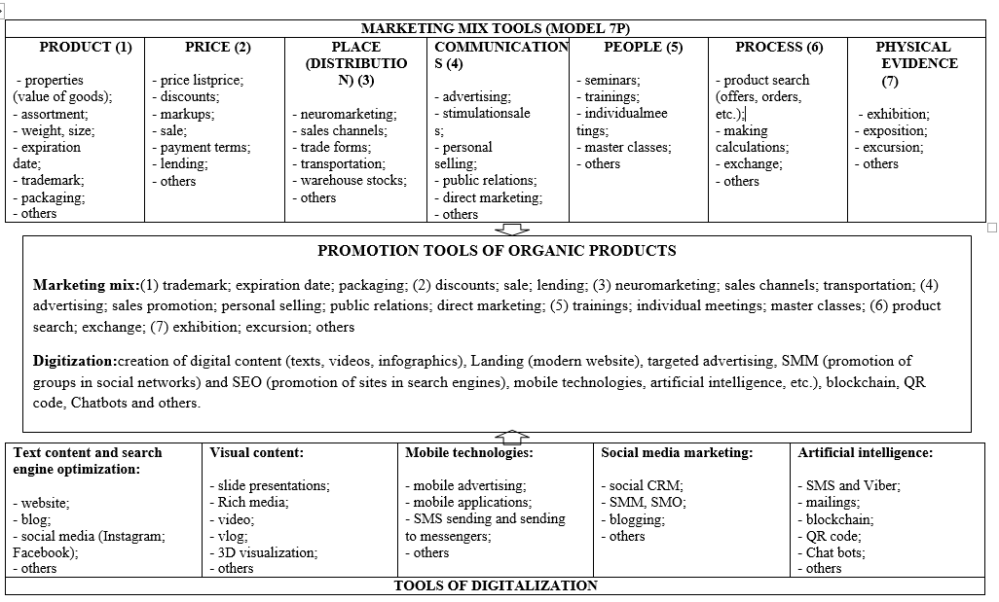
The most appropriate digital tools for promoting organic products

Slide 7
In order to effectively manage the promotion of organic products at an enterprise, it is important to create an optimal organisational structure that includes several key stages.
Firstly, it is necessary to choose an appropriate organisational structure, which can be linear, functional, line-staff or vertically integrated, depending on the scale and specifics of the enterprise. For example, a functional structure is effective for small and medium-sized enterprises with a limited product range, while a vertically integrated system allows for the consolidation of several enterprises, which allows for greater management efficiency and adaptability to market changes.
Secondly, to achieve successful promotion of organic products, it is important to develop a functional marketing structure that includes market research, assortment planning, advertising, sales and service. An important element is also information and communication systems that ensure effective interaction between the company's departments, which is necessary for the correct positioning of products, sales planning and logistics processes.
The third important aspect is strategic planning for the promotion of organic products, which includes market analysis, consumer behaviour, competitors and sales channels. This allows us to form target market segments, develop product positioning and ensure its effective promotion. In addition, it is necessary to constantly control and monitor through digital means to provide feedback to the consumer and adapt strategies in line with market trends.

Slide 8
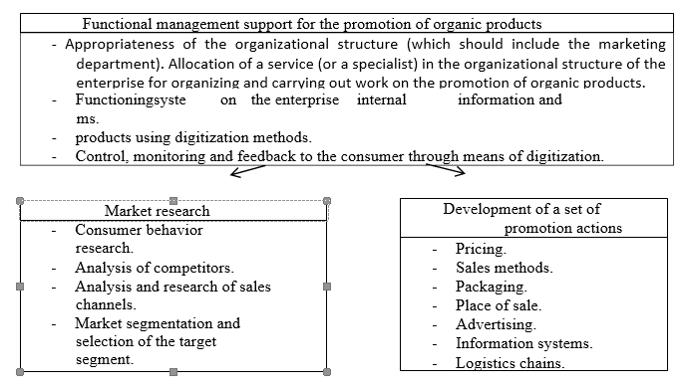
Based on the analysis, we have formed a logical and structural scheme for building a management system for the promotion of organic products at an enterprise:

Slide 9
An analysis of the external environment for the promotion of organic products shows that the organic market occupies an important place in the global market, with organic food reaching over $500 million in retail sales.
The national market for organic products is characterised by the presence of both direct and indirect competitors, in particular, dairy, meat, vegetable and other products.
Organic producers face high certification costs, low yields and intense competition, which makes organic products significantly more expensive than conventional ones (the difference can be 80% or more).The main consumers of organic products are young people with higher education and average or above average income.
The classification of organic consumers varies from country to country. For example, in Denmark, there are ‘anti-consumers’, ‘light consumers’ and ‘heavy consumers’, in Poland - ‘steadfast’, ‘traditional’ and others, and in Spain - ‘regular’ and ‘occasional’ consumers.
The classification of organic consumers is based on their attitude to organic production, brand loyalty and certification, motives (environmentalists, organic followers, sceptics) and lifestyle (active or passive).

Slide 10
Among the tools to support the organic sector in the world, subsidies (Paramparagat Krishi Vikas Yojana) and specific initiatives to support the development of the organic market are effective:
technical support (League of Organic Agriculture Municipalities and Cities (LOAMC)),
public procurement (Sweden - Policy for Sustainable Development and Food, Spain - Organic Products for Social Consumption, Brazil - National School Catering Programme (PNAE)),
national/regional development plans (National Organic Action Plan (NOAP) and Organic Action Plan for Ireland (2019-2025)),
insurance (US Farm Bill),
partial coverage of certification costs (US Farm Bill),
European Network for Rural Development (ENRD),
investments in research and technological development (Organic Science Cluster),

Slide 11
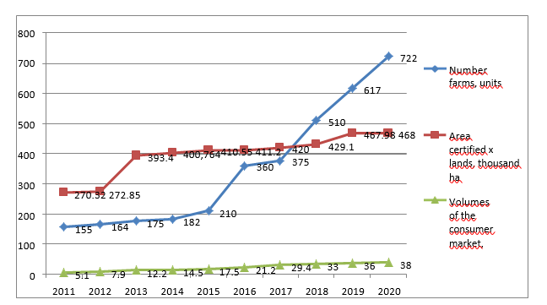
Ukraine has an established organic market, but domestic sales of organic products are much lower than exports. At the same time, there is a positive trend in the development of domestic production, in particular due to the growth of the area under organic production.
The largest consumer countries of Ukrainian organic products are the Netherlands, the US, Germany, the UK, Poland and other European countries. The Ukrainian organic market currently has a volume of about EUR 38 million per year, and the area under organic production is 462 thousand hectares (approximately 1% of total agricultural land).
According to the market research, 70.3% of respondents consume organic products, including dairy products, honey, berries and juices, and speciality stores are in the greatest demand. However, 36.4% said they do not buy organic products because of their high price. This indicates the need to better inform consumers about the benefits of organic products and improve their availability on the domestic market.
Dynamics of changes in the organic market in Ukraine

Slide 12
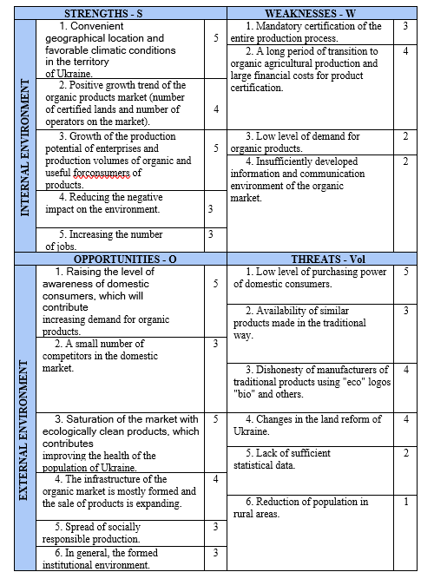
Strategic analysis of the internal and external environment helps to identify opportunities and prospects for organic enterprises. For this purpose, strategic analysis methods such as SWOT and PEST are used. A SWOT analysis identifies the strengths and weaknesses of enterprises in the organic market, as well as opportunities and threats. PEST analysis allows to assess the political, economic, social and technological factors that may affect the company's entry into the foreign market.
Matrix of SWOT-analysis of enterprises in the organic market in Ukraine Ukraine
When conducting the SWOT analysis, we used the method of expert assessments (quantification of qualities by interviewing specialists involved in the promotion, marketing or sale of organic products). The expert survey included the opinions of 20 experts on the promotion and sale of organic products in the domestic market. According to the SWOT analysis score, it can be concluded that in the domestic organic market, strengths (S) and opportunities (O) - 43 points, have an advantage over weaknesses (W) and threats (T) - 30 points.

Slide 13
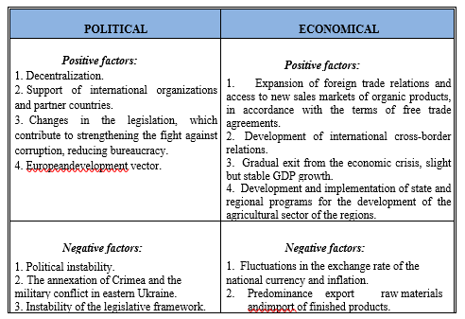
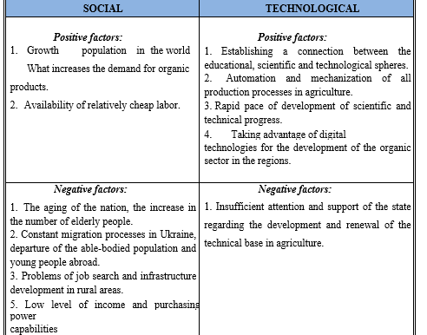
We use PEST analysis to take into account favourable and unfavourable environmental conditions, especially when introducing organic products to foreign markets. This method allows us to assess key trends in the industry when entering foreign markets and the impact on business of factors independent of production processes.In accordance with the PEST analysis method, we have formed a matrix to determine the impact of the external environment on enterprises that produce, process and sell organic products

Slide 14
Promotion strategies:
Deep market penetration and market niche - for new markets, where it is important to take into account the specifics of transportation and the demand for organic products.
Differentiation - to strengthen competitive positions in already known markets through the creation of new products or the use of price, product and communication differentiation.
Strengthening competitive positions - for existing enterprises through monitoring consumer priorities and improving promotion efficiency.
Marketing tools and channels: The choice of promotion tools depends on the strategy and helps to effectively promote organic products, which ensures high demand and satisfaction of consumer needs.
This approach contributes to the formation of a positive image of the enterprise on the market of organic products and maintaining constant communication with the target audience through digital platforms.

Slide 15
Recommendations for further development:
We predict that the organic market in Ukraine will grow due to increased labor productivity, the development of effective methods of certification and sale of organic products.
To ensure sustainable growth, it is necessary to promote the increase of labor productivity in the agricultural sector and the development of the market for finished organic products.
This approach makes it possible to forecast and evaluate the potential of the development of the organic market, taking into account the factors that affect its dynamics.

Slide 16
To succeed in organic production, it is necessary to integrate different levels of management (macro-, meso-, micro-level) and interact with government agencies, NGOs and other market participants.
To this end, we propose a model of a three-tiered integrated management system that will combine different functional subsystems and ensure efficient use of resources. This also includes the introduction of digital technologies to automate the processes of collecting and processing information, which will facilitate the rapid launch of the system.
As a result, the integration of management entities at all levels will strengthen ties in the industry, improve management efficiency and contribute to the growth of the organic market in Ukraine.

Slide 17
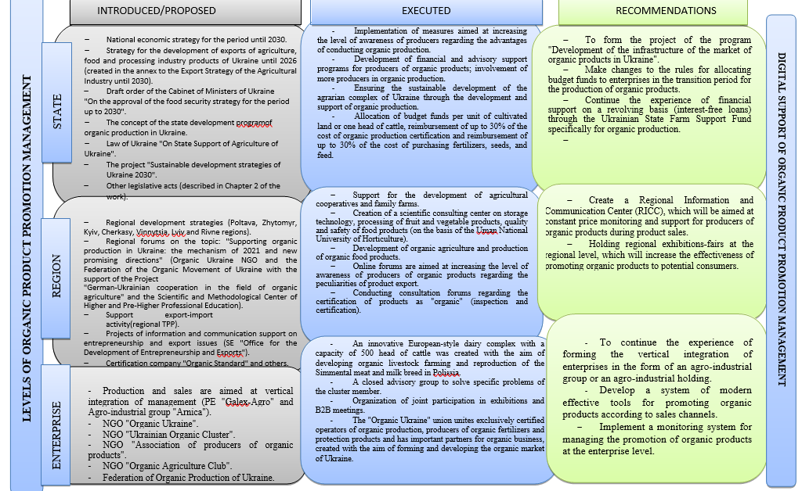

Slide 18
We have formulated proposals for the draft program “Development of the Organic Market Infrastructure in Ukraine”. The project aims to create favorable conditions for the development of the organic market by improving organizational, economic and communication conditions:
1. improving interaction between producers and consumers: development of specialized intermediaries, transportation services, storage, processing and packaging.
2. stimulating organic enterprises: creation of regional information and communication centers.
3. protection of small farmers: support and protection of interests of organic producers.
4. Improving economic efficiency and living standards: stimulating the sale of organic products and their promotion.
Proposals include:
- Increasing compensation for organic producers.
- Extension of interest-free loans through the Ukrainian State Fund for Support of Organic Production.
Regional information and communication centers to help producers with sales and price monitoring.

Slide 19
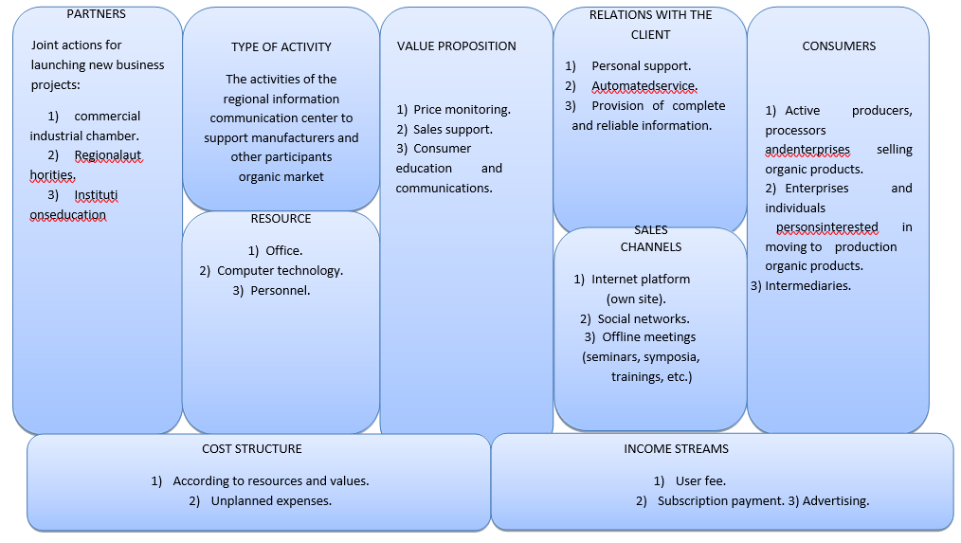
To reveal the main functions of the regional information and communication center for support of organic producers, we have built a schematic concept based on the CANVAS business model. According to it, we have identified: the type of activity of the center, resources, main partners, value proposition, customer relations, sales channels and consumers
The establishment of a regional information and communication center to support organic producers will help strengthen their market position.

Slide 20
Thank you for your attention!

